Slide 1
أذيات الرأس الرضية
د . باسل عنيزان
شعبة الجراحة العصبية - مشفى دمشق

Slide 2
TRAUMA HEAD INJURY
Scalp Injury
❏ rich blood supply
❏ considerable blood loss (vessels contract poorly when ruptured)
❏ minimal risk of infection due to rich vascularity

Slide 3
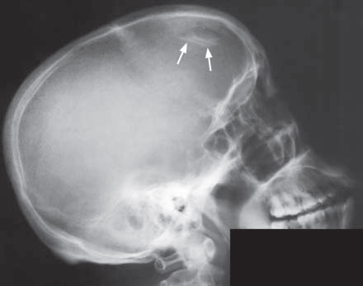
Skull Fractures
❏ depressed fractures ––> double density on skull x-ray
• simple fractures
• compound fractures ––> increased risk of infection
❏ internal fractures into sinus ––> meningitis, pneumocranium

Slide 8
❏ basal skull fractures ––> not readily seen on x-ray, rely on clinical signs
• retroauricular ecchymoses (Battle’s sign)
• periorbital ecchymoses (raccoon eyes)
• hemotympanum
• CSF rhinorrhea, otorrhea
• suspect with Lefort II or III midface fracture

Slide 12
Cranial Nerve Injury
❏ most commonly olfactory
Arterial Injury
❏ e.g. carotid-cavernous (C-C) fistula, carotid/vertebral artery dissection

Slide 13
INTRACRANIAL BLEEDING
Extradural (“Epidural”) Hematoma
❏ young adult, male > female
❏ temporal-parietal skull fracture ––> ruptured middle meningeal artery
❏ symptoms: lateral transtentorial herniation, classically there is lucid interval between concussion and coma

Slide 14
❏ prognosis: good with optimal prompt management, since the brain is often not damaged
❏ CT without contrast: high density biconvex mass against skull, usually with uniform density
and sharp margins “lens-shaped”
❏ management: head elevation, mannitol pre-operatively, evacuation with small craniotomy

Slide 17
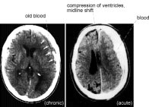
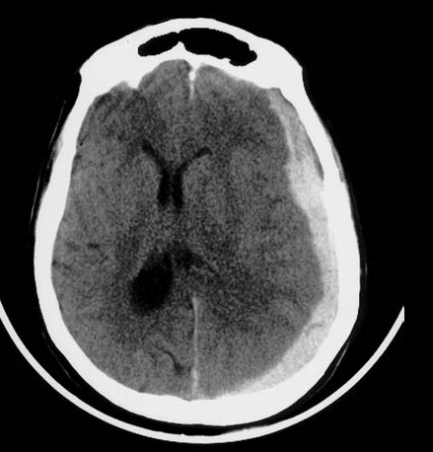
Subdural Hematoma
❏ acute
• arise from rupture of a vessels that bridge the surface of the cerebral hemisphere and the skull
(e.g. cortical artery, large vein, or venous sinus) due to violent trauma

Slide 19
• prognosis: poor overall, since the brain is often injured
• CT: high density concave mass usually less uniform, less dense and more diffuse
than extradural hematoma
• management: craniotomy

Slide 21
❏ chronic
• often due to minor injuries or no history of injury
• several weeks after injury
• the clot from the original bleed liquifies and becomes bounded by a thick, friable,
vascularized outer membrane and a thin, lucent inner membrane.

Slide 22
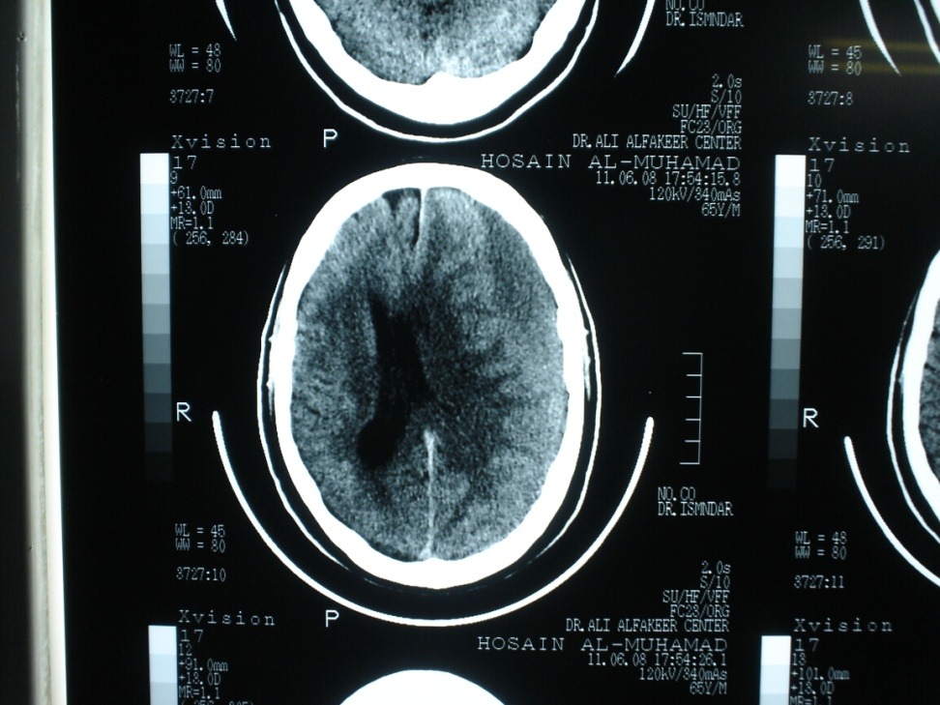

Slide 23
• symptoms of raised ICP and sometimes seizures, progressive dementia, gait problem,
obtundation out of proportion to focal neurological deficit, “the great imitator”
(of dementia, tumours, etc.), normal pressure hyrocephalus (NPH)

Slide 24
• risk factors: older, alcoholic, patients with CSF shunts, anticoagulants
• expands due to repeated bleeding

Slide 25
• prognosis: brain usually undamaged, however, recurrent bleeding from the outer membrane leads
to expansion of the hematoma, increased ICP, shift of the cerebral hemispheres,
transtentorial herniation, and death

Slide 26
• CT: low density (liquefied clot) concave mass
• management: burr hole drainage, craniotomy if recurrent

Slide 29
Comparison between subdural and epidural haematomas
EPIDURAL HAEMATOMA SUBDURAL HAEMATOMA
Incidence 1-4% of trauma cases; 10-20% of all trauma cases;
10% of fatal trauma cases 30% of fatal trauma cases
Aetiology Associated fractures in 85-95% of cases; Tearing of the cortical veins of the pons
Laceration of middle meningeal
artery/dural venous sinus in 70-80% of cases.
Site Between skull and dura mater; Between dura mater and arachnoid mater;
Crosses the dura mater Crosses the cranial suturesbut not the dura mater;
but not the cranial sutures; 95% are supratentorial;
95% are supratentorial 5% are bilateral
5% are subtentorial;
5% bilateral CT findings Biconvex (lens) shape; Acute: 60% hyperdense;
Shifts the white-grey matter interface; 40% mixed (hyper-/hypodense)
66% are hyperdense; Subacute: isodense;
33% are mixed (hyper-/hypodense) Chronic: hypodense

Slide 30
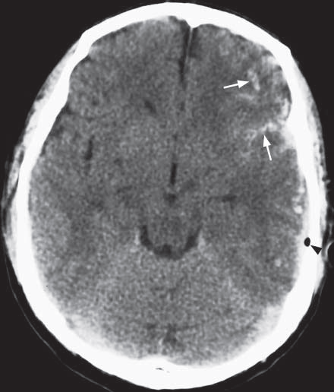
Subarachnoi haemorrhage
1. Aneurysm, 90% of the cases
2. Arterio-venous malformation
(AVM)
3. Coagulation disorder
4. Extension from intra-parenchymal haemorrhage
5. Trauma
6. Idiopathic

Slide 34
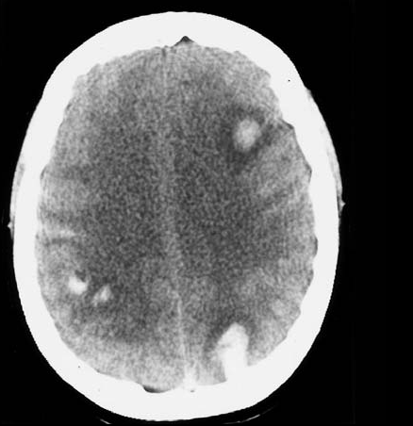
Traumatic Intracerebral Hemorrhage
❏ any size, any part of brain, may be multiple
❏ immediate or delayed
❏ frontal and temporal lobes most commonly injured (by coup/contre-coup mechanism)

Slide 35
BRAIN INJURY
Primary Impact Injury
❏ mechanism of injury determines pathology: i.e. with penetrating injuries, gun shot wounds
• low velocity ––> local damage
• high velocity ––> distant damage possible (due to wave of compression)

Slide 37
❏ concussion
• American Academy of Neurology (AAN) definition: “a trauma-induced alteration in mental status
that may or may not involve loss of consciousness”

Slide 38
• AAN Classification:
Grade 1: altered mental status <15 min
Grade 2: altered mental status >15 min
Grade 3: any loss of consciousness
• no parenchymal abnormalities on CT

Slide 39
❏ coup (damage at site of blow)
❏ contre-coup (damage at opposite site of blow)
• acute decompression causes cavitation
• followed by a wave of acute compression

Slide 40
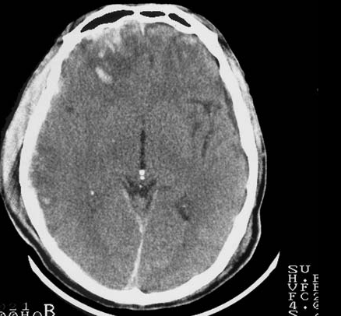
❏ contusion (hemorrhagic)
• high density areas on CT with little mass effect
• commonly occurs with brain impact on bony prominences (falx, sphenoid wing, floor of frontal
and temporal fossae)

Slide 41
❏ diffuse axonal injury (diffuse axonal shearing)
• may tear blood vessels->hemorrhagic foci (may not be proportionate to axonal injury)
• wide variety of damage results
• all brain injury causes shear
• often the cause of decreased LOC if no space occupying lesion on CT

Slide 42
Secondary Pathologic Processes
❏ 1/3 who die in hospital after head injury were able to talk after the injury
❏ delayed and progressive injury to the brain due to:
• edema
• intracranial hemorrhages
• ischemia/infarction
• raised ICP (which leads to (decreased cerebral perfusion pressure (CPP) and herniation

Slide 44
Extracranial Conditions
❏ hypoxemia
• trauma: chest, upper airway, brainstem
• exceptionally damaging to traumatized brain cells
• leads to ischemia, raised ICP
❏ hypercarbia
• leads to raised ICP (secondary to vasodilation)

Slide 45
❏ systemic hypotension
• caused by blood loss, not by head injury (e.g. ruptured spleen)
• cerebral autoregulation lost in trauma
• leads to decreased CPP, ischemia
❏ hyperpyrexia
• leads to increased brain metabolic demands

Slide 46
❏ fluid and electrolyte imbalance
• iatrogenic (most common)
• syndrome of inappropriate antidiuretic hormone (SIADH) secretion (from head injury)
• diabetes insipidus (DI) (from head injury)
• may lead to cerebral edema and raised ICP

Slide 47
❏ fat embolism
• multiple trauma
• long bone fractures
• petechiae and edema
• hypoxia a key feature due to pulmonary effects

Slide 48
❏ coagulopathy
❏ post-traumatic carotid artery dissection

Slide 49
Intracranial Conditions
❏ raised ICP due to
• traumatic cerebral edema OR traumatic intracranial hemorrhage
❏ raised ICP results in
• decreased cerebral perfusion (CPP = MAP – ICP)
• +/– herniation

Slide 51
LATE COMPLICATIONS OF HEAD INJURY
Seizures
❏ 5% of head injury patients develop seizures
❏ incidence related to severity and location of injury ––> increased with local brain damage
or intracranial hemorrhage
❏ post-traumatic seizure may be immediate, early, or late
❏ presence of early (within first week) post traumatic seizure, incidence of later seizures rises to 25%

Slide 52
Meningitis
❏ associated with CSF leak from nose or ear
Hydrocephalus
❏ acute hydrocephalus or delayed normal pressure hydrocephalus (NPH)

Slide 55
Post-traumatic sequelae of head injuries
1) - Cortical atrophy
2) - Encephalomalacia
3) - Pneumocephalus
4) - Leptomeningeal cyst formation
5) - Cranial nerve lesions
6) - Diabetes insipidus (pituitary injury)
7) - Hydrocephalus (communicating or obstructive)

Slide 56
نشكرحسن استماعكم

